Slide 1


SALES DATA VISUALIZATION
TEAM MEMBERS:
NARAYANA.V [ 927623BAM041]
NIVASHINI.R [927623BAM042]
PRATHISH.S [927623BAM043]
RAJA PRABHU.C [927623BAM044]
RAKSHITHA.D [927623BAM045]

Slide 2
PROBLEM STATEMENT / DESCRIPTION:
STATEMENT :
sales data from a CSV file, visualize the monthly sales using matplotlib, and provide summary information about the sales data.
DESCRIPTION :
Read CSV Data
Extract Data
Visualize Sales Data
Calculate Total Sales
Display Summary Information

Slide 3
ABSTRACT :
The script uses “pandas” and “matplotlib” to read monthly sales data from a CSV file named “stores.csv” .It visualizes the sales data with a line plot showing sales over different months.
The plot is customized with red color, grid lines, and axis labels. After visualizing the data, the script calculates and displays the total sales amount for all months in Indian Rupees (₹), with two decimal places. Additionally, it identifies and prints the highest and lowest sales months along with their corresponding sales amounts. This script provides a practical example of data loading, visualization, and basic analysis using popular “Python libraries” for data manipulation and plotting.

Slide 4
PROPOSED SOLUTION :
Error Handling :
We might also consider adding more specific error handling or logging for other potential issues with the CSV file. Ex: FileNotFoundError
Consistent Message Formatting :
Ensure consistent formatting in the output messages.
Chart Customization :
Consider adding additional customization options to your visualization, such as changing plot styles, adding legends, or highlighting specific data points.

Slide 5
REAL LIFE APPLICATION:
Sales Performance Analysis:
Companies can use this program to analyze and visualize their monthly sales data. It helps in understanding sales trends, identifying peak sales months, and optimizing sales strategies.
Financial Reporting:
Finance departments can use this program to generate visual reports of monthly sales figures. It helps in budget forecasting, performance evaluation, and financial planning.
E-commerce Platforms:
E-commerce businesses can apply this program to analyze sales data for different product categories or regions.
Startup Analytics:
Startups can use this program to monitor their revenue growth over months

Slide 6
HARDWARE AND SOFTWARE REQUIREMENTS:
Hardware Requirements:
Computer: Any modern computer capable of running Python will suffice.
Input Device: A keyboard for user input.
Display: A monitor or screen to display the program output.
Internet Connection: Required for installing Python and libraries (optional).

Slide 7
HARDWARE AND SOFTWARE REQUIREMENTS:
Software Requirements:
Python: The program is written in Python, so you'll need to have Python installed on your computer. You can download Python from the official website: https://www.python.org/downloads/
Required Libraries: The program uses the following libraries.
Pandas: For data manipulation and analysis.
Matplotlib: For data visualization.
You can install these libraries using pip, Python's package manager, by running the following commands in your command line or terminal:
pip install pandas
pip install matplotlib
Operating System: The program should work on any major operating system such as Windows, macOS, or Linux

Slide 8
PROJECT CODE:
import pandas as pd
import matplotlib.pyplot as plt
def information(months, sales
df = pd.DataFrame({'Month': months, 'Sales': sales})
plt.figure(figsize=(8, 5))
plt.plot(df['Month'], df['Sales'], marker='o', linestyle='-', color='red')
plt.title('Monthly Sales Data')
plt.xlabel('Month')
plt.ylabel('Sales (INR)')
plt.grid(True)
plt.tight_layout()
plt.show()
def main():
try:
df = pd.read_csv('/content/Stores.csv')

Slide 9
PROJECT CODE:
except FileNotFoundError:
print("Error: CSV file not found.")
return
months=df['Month'].tolist()
sales =df['Sales'].tolist()
information(months, sales)
total_sales = sum(sales)
print(f"\n\t\tTotal sales amount for all months: ₹{total_sales:.2f}\n")
if months:
max_sales_month = months[sales.index(max(sales))]
min_sales_month = months[sales.index(min(sales))]
print(f"\t\tHighest sales month: {max_sales_month} (₹{max(sales):.2f})\n")
print(f"\t\tLowest sales month:{min_sales_month}(₹{min(sales):.2f})\n")
main()

Slide 10
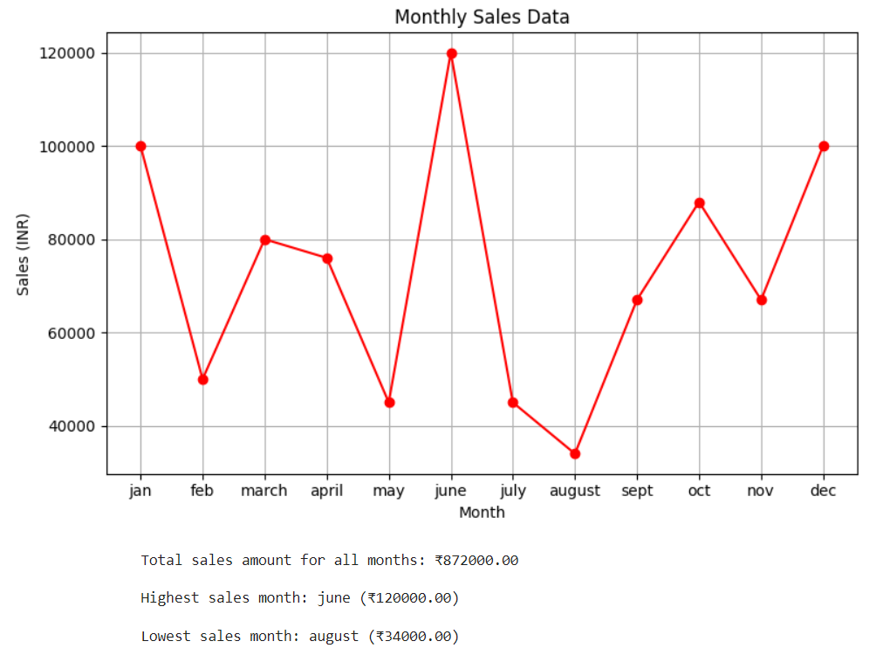
OUTPUT:

Slide 11
THANK YOU !

